Slide 1
Web Application?
GraduatIng TO make Wed apps

Slide 2
Overview
Where to Start, What to do and How?
Fullstack, Backend vs Frontend
Technology stack
Testing, Testing and Testing, cause you can’t have enough test.
Mockito
Protractor
SQL vs No-SQL which to use for your application.
MySQL
MongoDB
Combining it all together and deploying it hopefully.
Spring Boot with Angular 6 on a Docker Container

Slide 3
Where to Start, What to do and How?
Problem?
Sometime the greatest idea comes from solving the simplest things.
Solving the Problem?
Technology stack
Break down the problem
Notes:
Sometime the greatest idea comes from solving the simplest things.

Slide 4
Full-Stack Development
Notes:
https://medium.com/@sepandassadi/become-a-full-stack-web-developer-free-resources-8a1c2c0ebd41

Slide 5

Back-End
Spring and Sprint Boot
Spring
Spring MVC
Spring Boot
Java 1.8
Gradle vs Maven
https://dzone.com/articles/gradle-vs-maven
Layered Architecture
Notes:
Spring Framework is an application framework
Spring Boot is basically an extension of the Spring framework which eliminated the boilerplate configurations required for setting up a Spring application.
Spring Boot makes it easy to create stand-alone, production-grade Spring based Applications that you can "just run".
Spring MVC is a sub-project of the Spring Framework, targeting design and development of applications that use the MVC (Model-View-Controller) pattern
Gradle is a build automation system that is fully open source and uses the concepts you see on Apache Maven and Apache Ant. It uses domain-specific language based on the programming language Groovy, differentiating it from Apache Maven, which uses XML for its project configuration. It also determines the order of tasks run by using a directed acyclic graph.
Maven is used for project build automation using Java. It helps you map out how a particular software is built, as well as its different dependencies. It uses an XML file to describe the project that you are building, the dependencies of the software with regards to third-party modules and parts, the build order, as well as the needed plugins. There are pre-defined targets for tasks such as packaging and compiling.

Slide 6
Front-End
JavaScript vs Typescript
Vue.js vs React.js vs Angular
https://vuejs.org/
https://reactjs.org/
https://angular.io/
Angular MVC
Notes:
JavaScript (JS) is a lightweight, interpreted, or just-in-time compiled programming language with first-class functions.
https://developer.mozilla.org/en-US/docs/Web/JavaScript
TypeScript is an open-source programming language developed and maintained by Microsoft. It is a strict syntactical superset of JavaScript, and adds optional static typing to the language. TypeScript is designed for development of large applications and transcompiles to JavaScript.
https://www.typescriptlang.org/

Slide 7
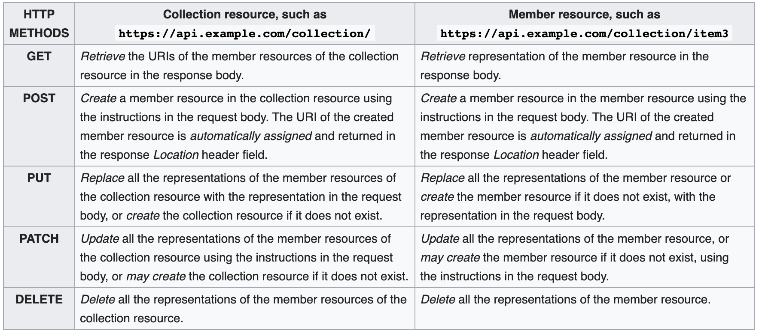
REST
Notes:
Representational State Transfer

Slide 8
APIs
Google API
https://developers.google.com/places/web-service/intro
YELP API
https://www.yelp.com/developers/documentation/v3
Open Data NI
https://www.opendatani.gov.uk/
Notes:
implementation 'com.google.maps:google-maps-services:0.9.3’
implementation 'org.springframework.boot:spring-boot-starter-web’
implementation 'org.apache.commons:commons-lang3:3.0'

Slide 9
Planning and Tracking your progress
Trello
https://trello.com/
Jira
https://www.atlassian.com/software/jira
Github
https://github.com/Jgiron455/webapp-workshop

Slide 10
Meet-ups
Java
https://www.meetup.com/BelfastJUG/
JavaScript
https://www.meetup.com/Belfast-JS/
https://www.meetup.com/

